Slide 1
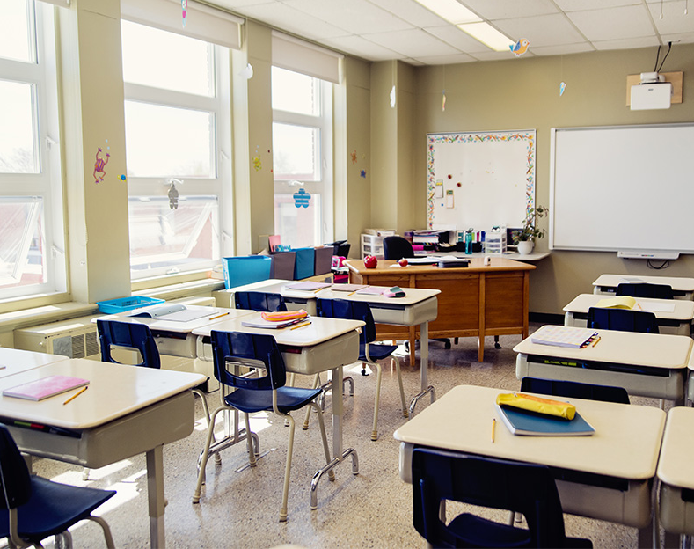
STUDENT ATTENDANCE MONITORING USING DEEP LEARNING IN A CLASSROOM 10th Mar 2021
15EC496L – Major Project
Batch number:12
Team members
1) K CHANDRASEKARAN RA1711004040028
2) S AATHITH RA1711004040030
Guide: Dr. S.Karthtik

Slide 2

Existing problem
Student’s attendance in the physical classroom is a very an important task.
The existing method of taking attendance consumes a finite of amount of time which can be used for other productive action.
We are focused on addressing this problem on schools and universities only. But also can be extended for organization.
Notes:
Physical classroom as covid situation changed the definition hahaha.

Slide 3
Objective
Automatically generates an attendance report for the students present in the classroom with minimal interaction of the teacher as well as student.
Notes:
Google classroom automatically generated the attendance of the members present in the meeting.
Inspired by this , we come up with this solution for the above stated problem.
Trying

Slide 4

Abstract
Monitoring the attendance of students is one of the major concerns in many educational institutions. The manual management of the attendance sheets is time consuming. Other existing methods( RFID, Biometrics, etc.) of taking attendance also consumes a finite of amount of time which can be used for other productive action and also has several disadvantages associated with it. Facial recognition solves some of the problems that exist in the previously mentioned attendance systems. We proposed a solution that uses facial recognition (based on deep learning) and makes sure that there is a minimal interaction between students and the attendance monitoring system.
Keywords – Deep learning, computer vision, Smart Attendance monitoring.

Slide 5
Motivation
We found this problem in many universities and schools.
We want a reliable system which identifies which student is present in the classroom and gives the attendance based on his presence.
This system must not be complex and very easy to interact with it.

Slide 6
Methodology
Every first 5th minute of the class period, an alarm goes off, to notify the students to face the camera.
The attendance report is generated and given to the staff through an app , wherein staff can also edit the attendance of a student.
Notes:
This happens every hour of the day.
So that the staff do have the power to edit any student’s attendance before being updated to the official database

Slide 7
Algorithms
Face detection
HOG (Histogram of Oriented Gradients)
As this is fast and can be run on CPU real time
Simple to implement
Face recognition
Dlib Algorithm based on Deep Learning
99.38% in the Labelled Faces in the Wild(LFW)
Very easy to implement
Notes:
We chose HOG for face detection as the HOG does not work for side face and extreme non-frontal faces, like looking down or up.
There is library called Face recognition

Slide 8
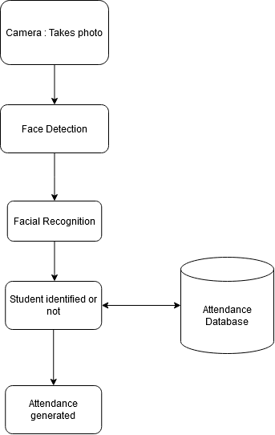
Flowchart

Slide 9
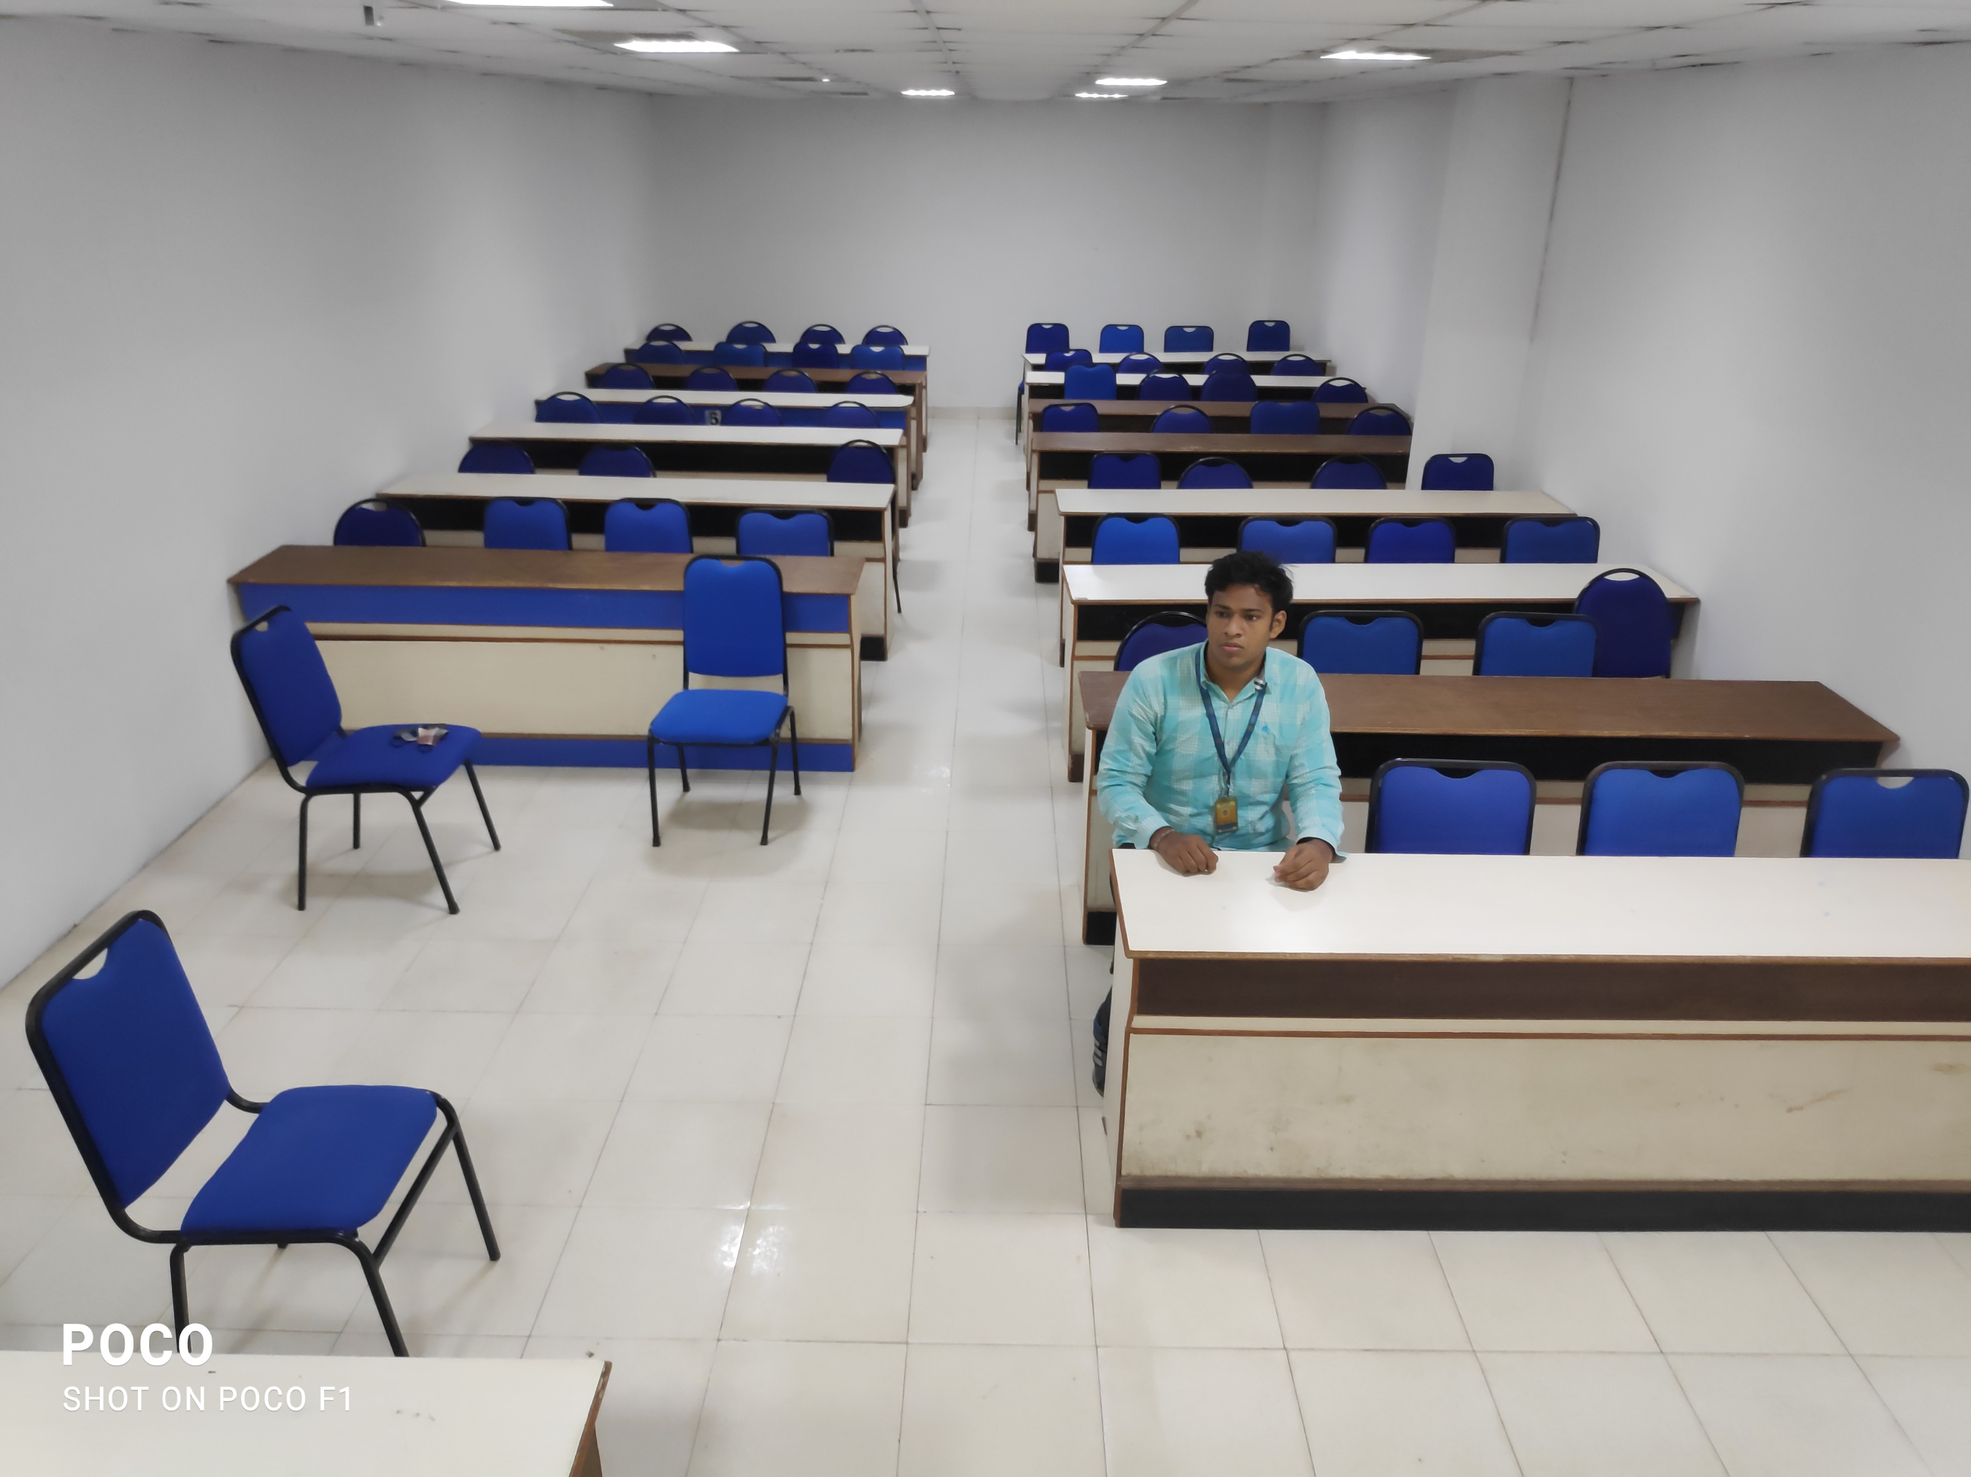
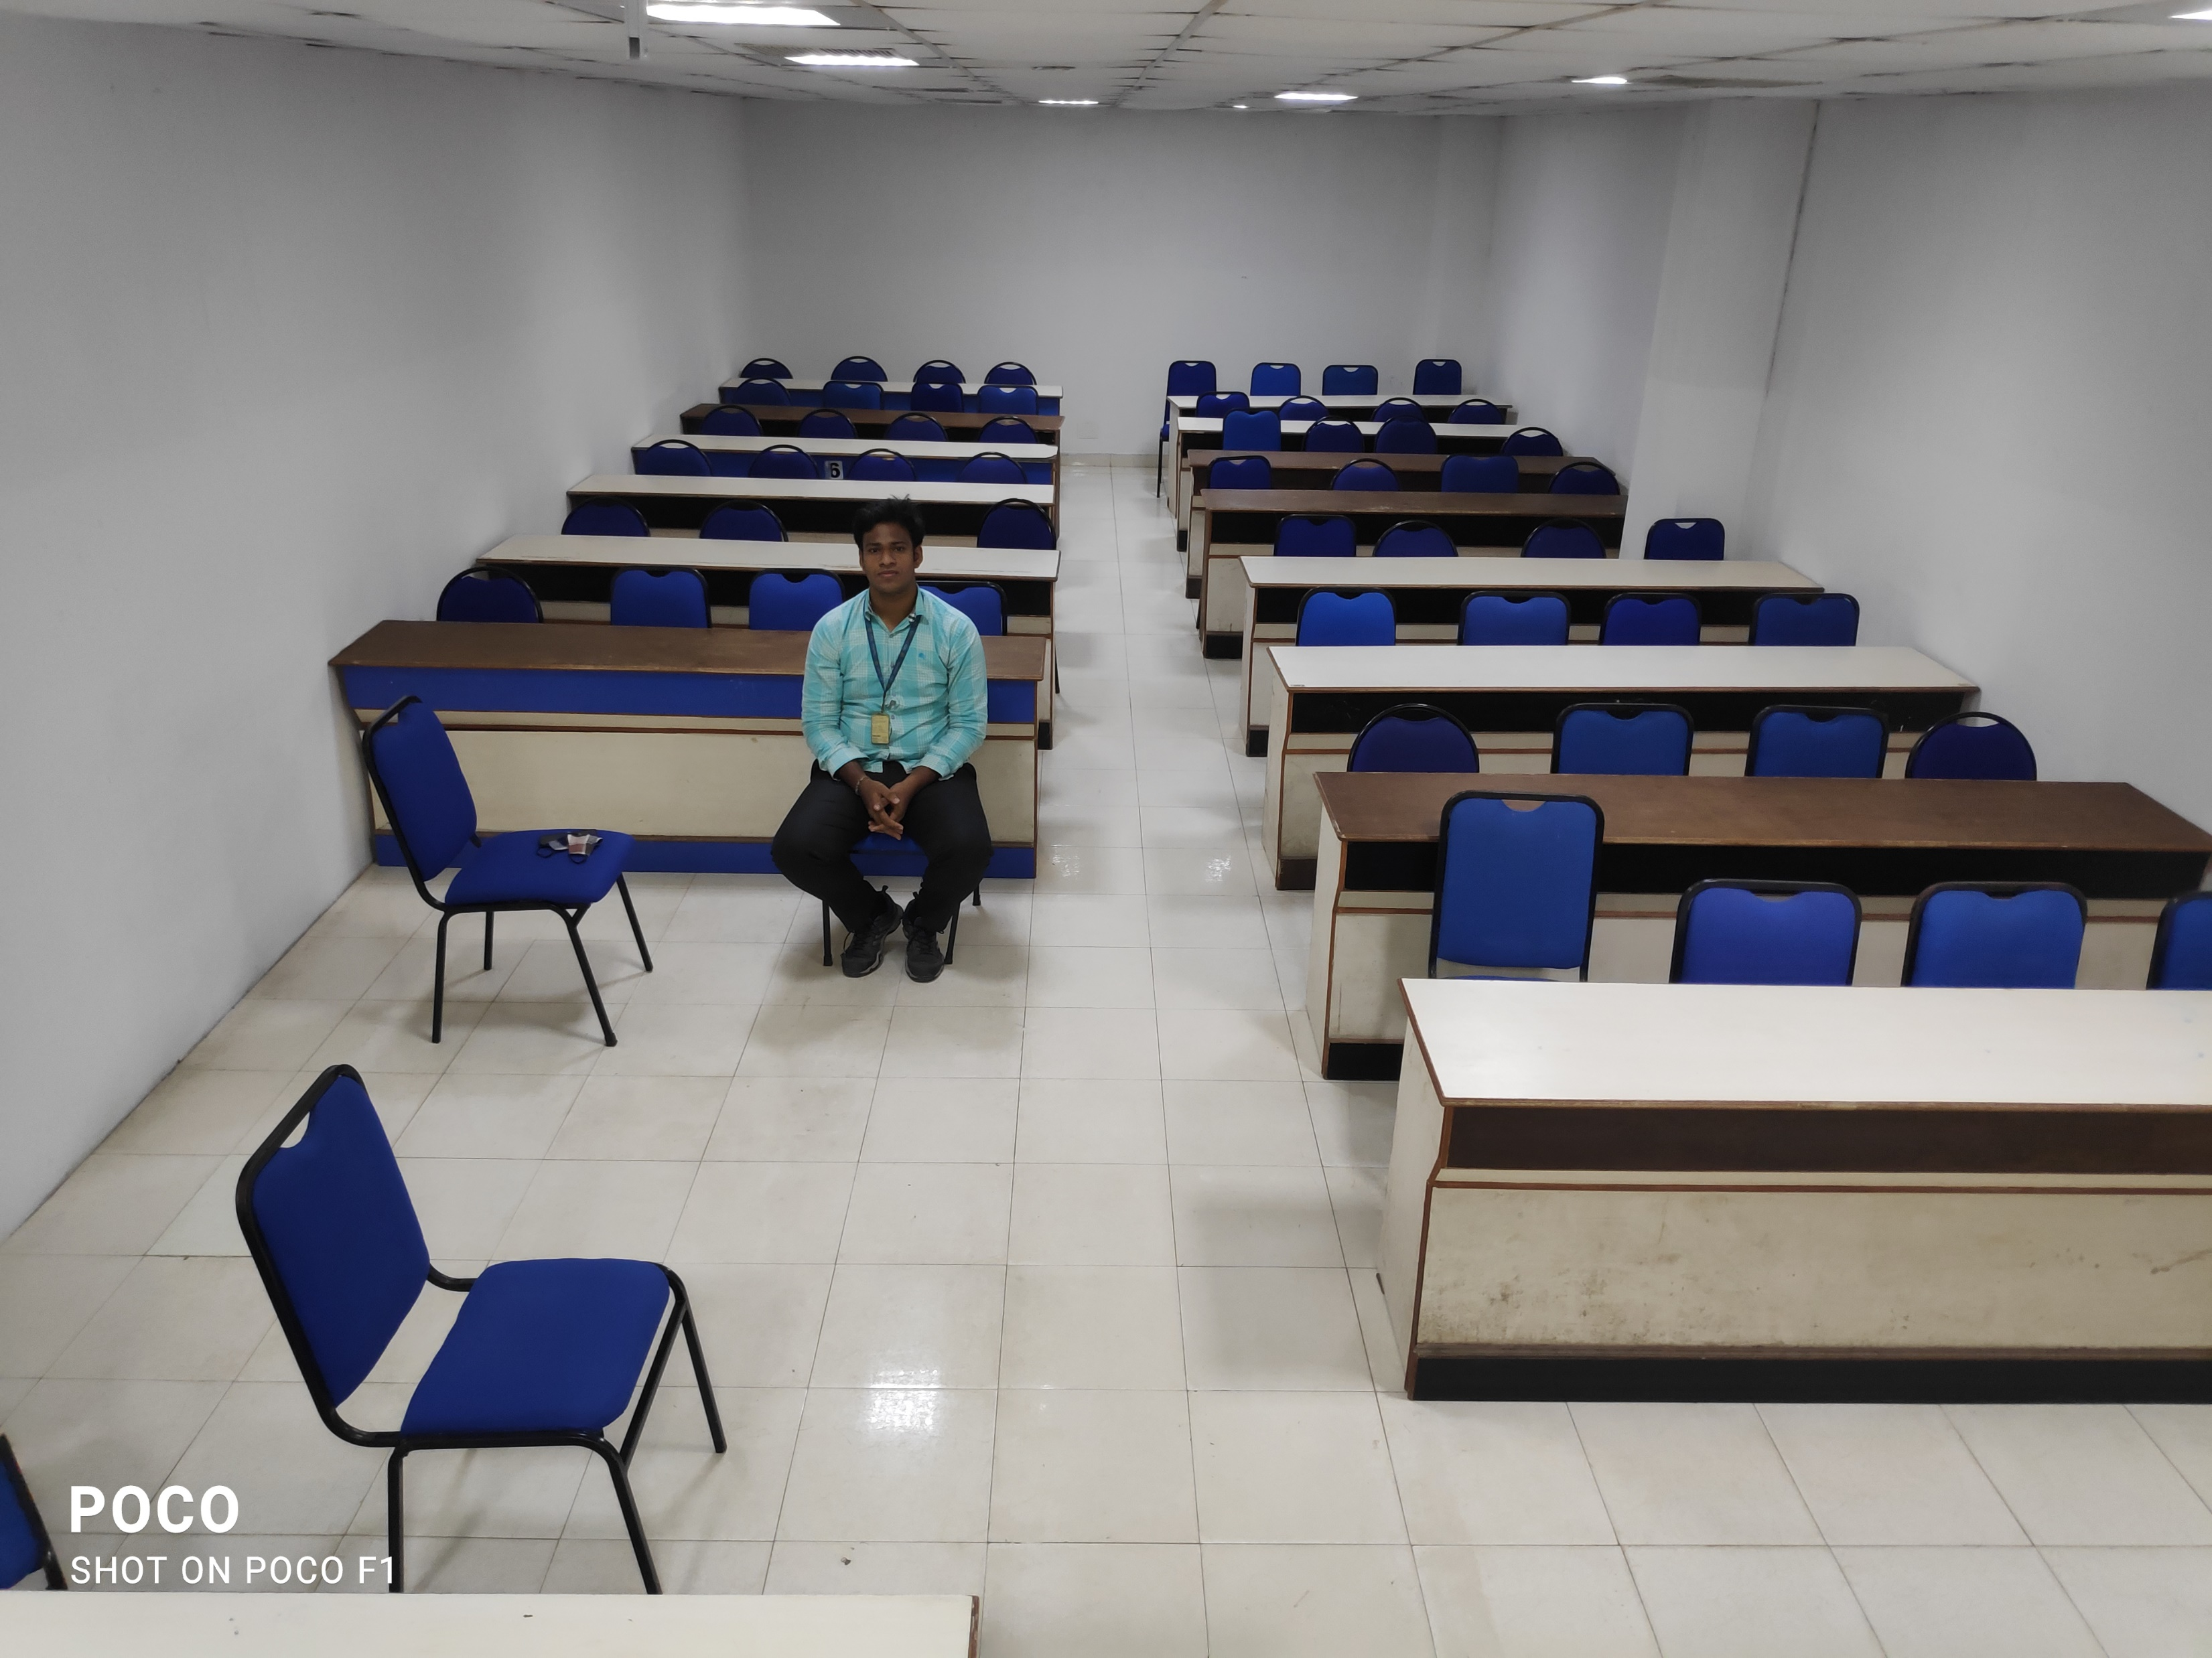
Photos taken Cls1 and Cls2

Slide 10
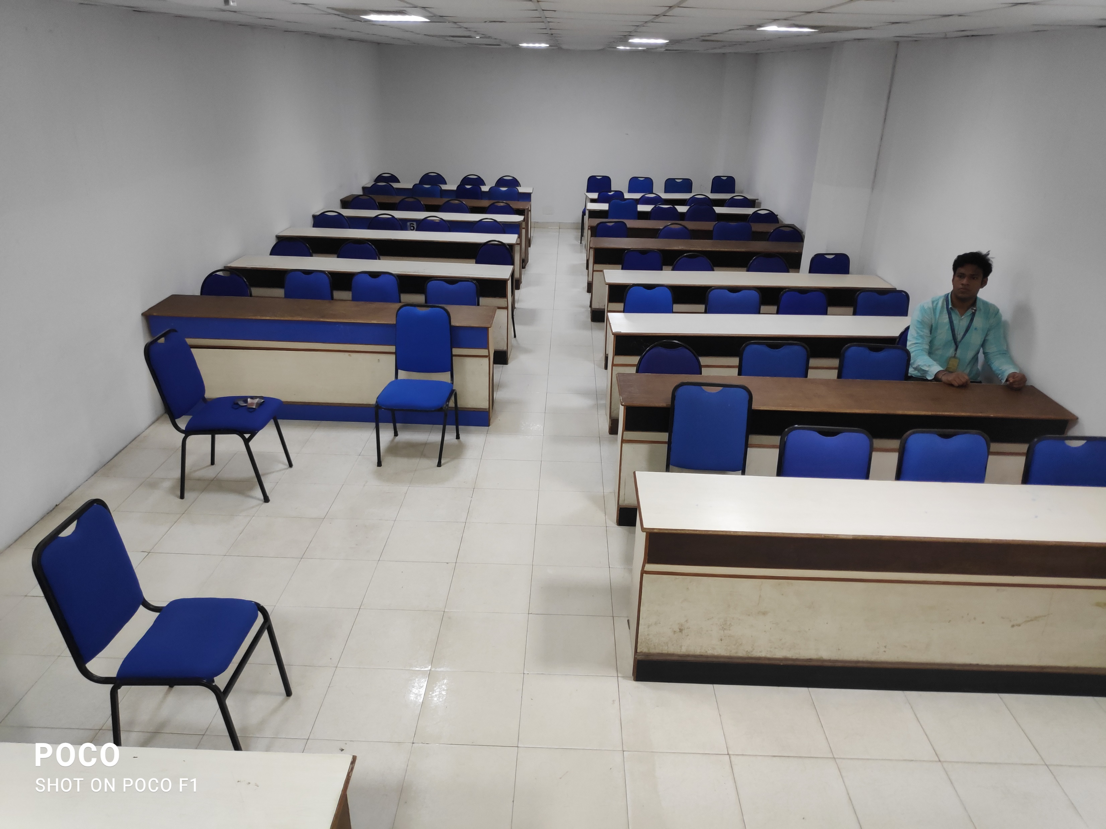
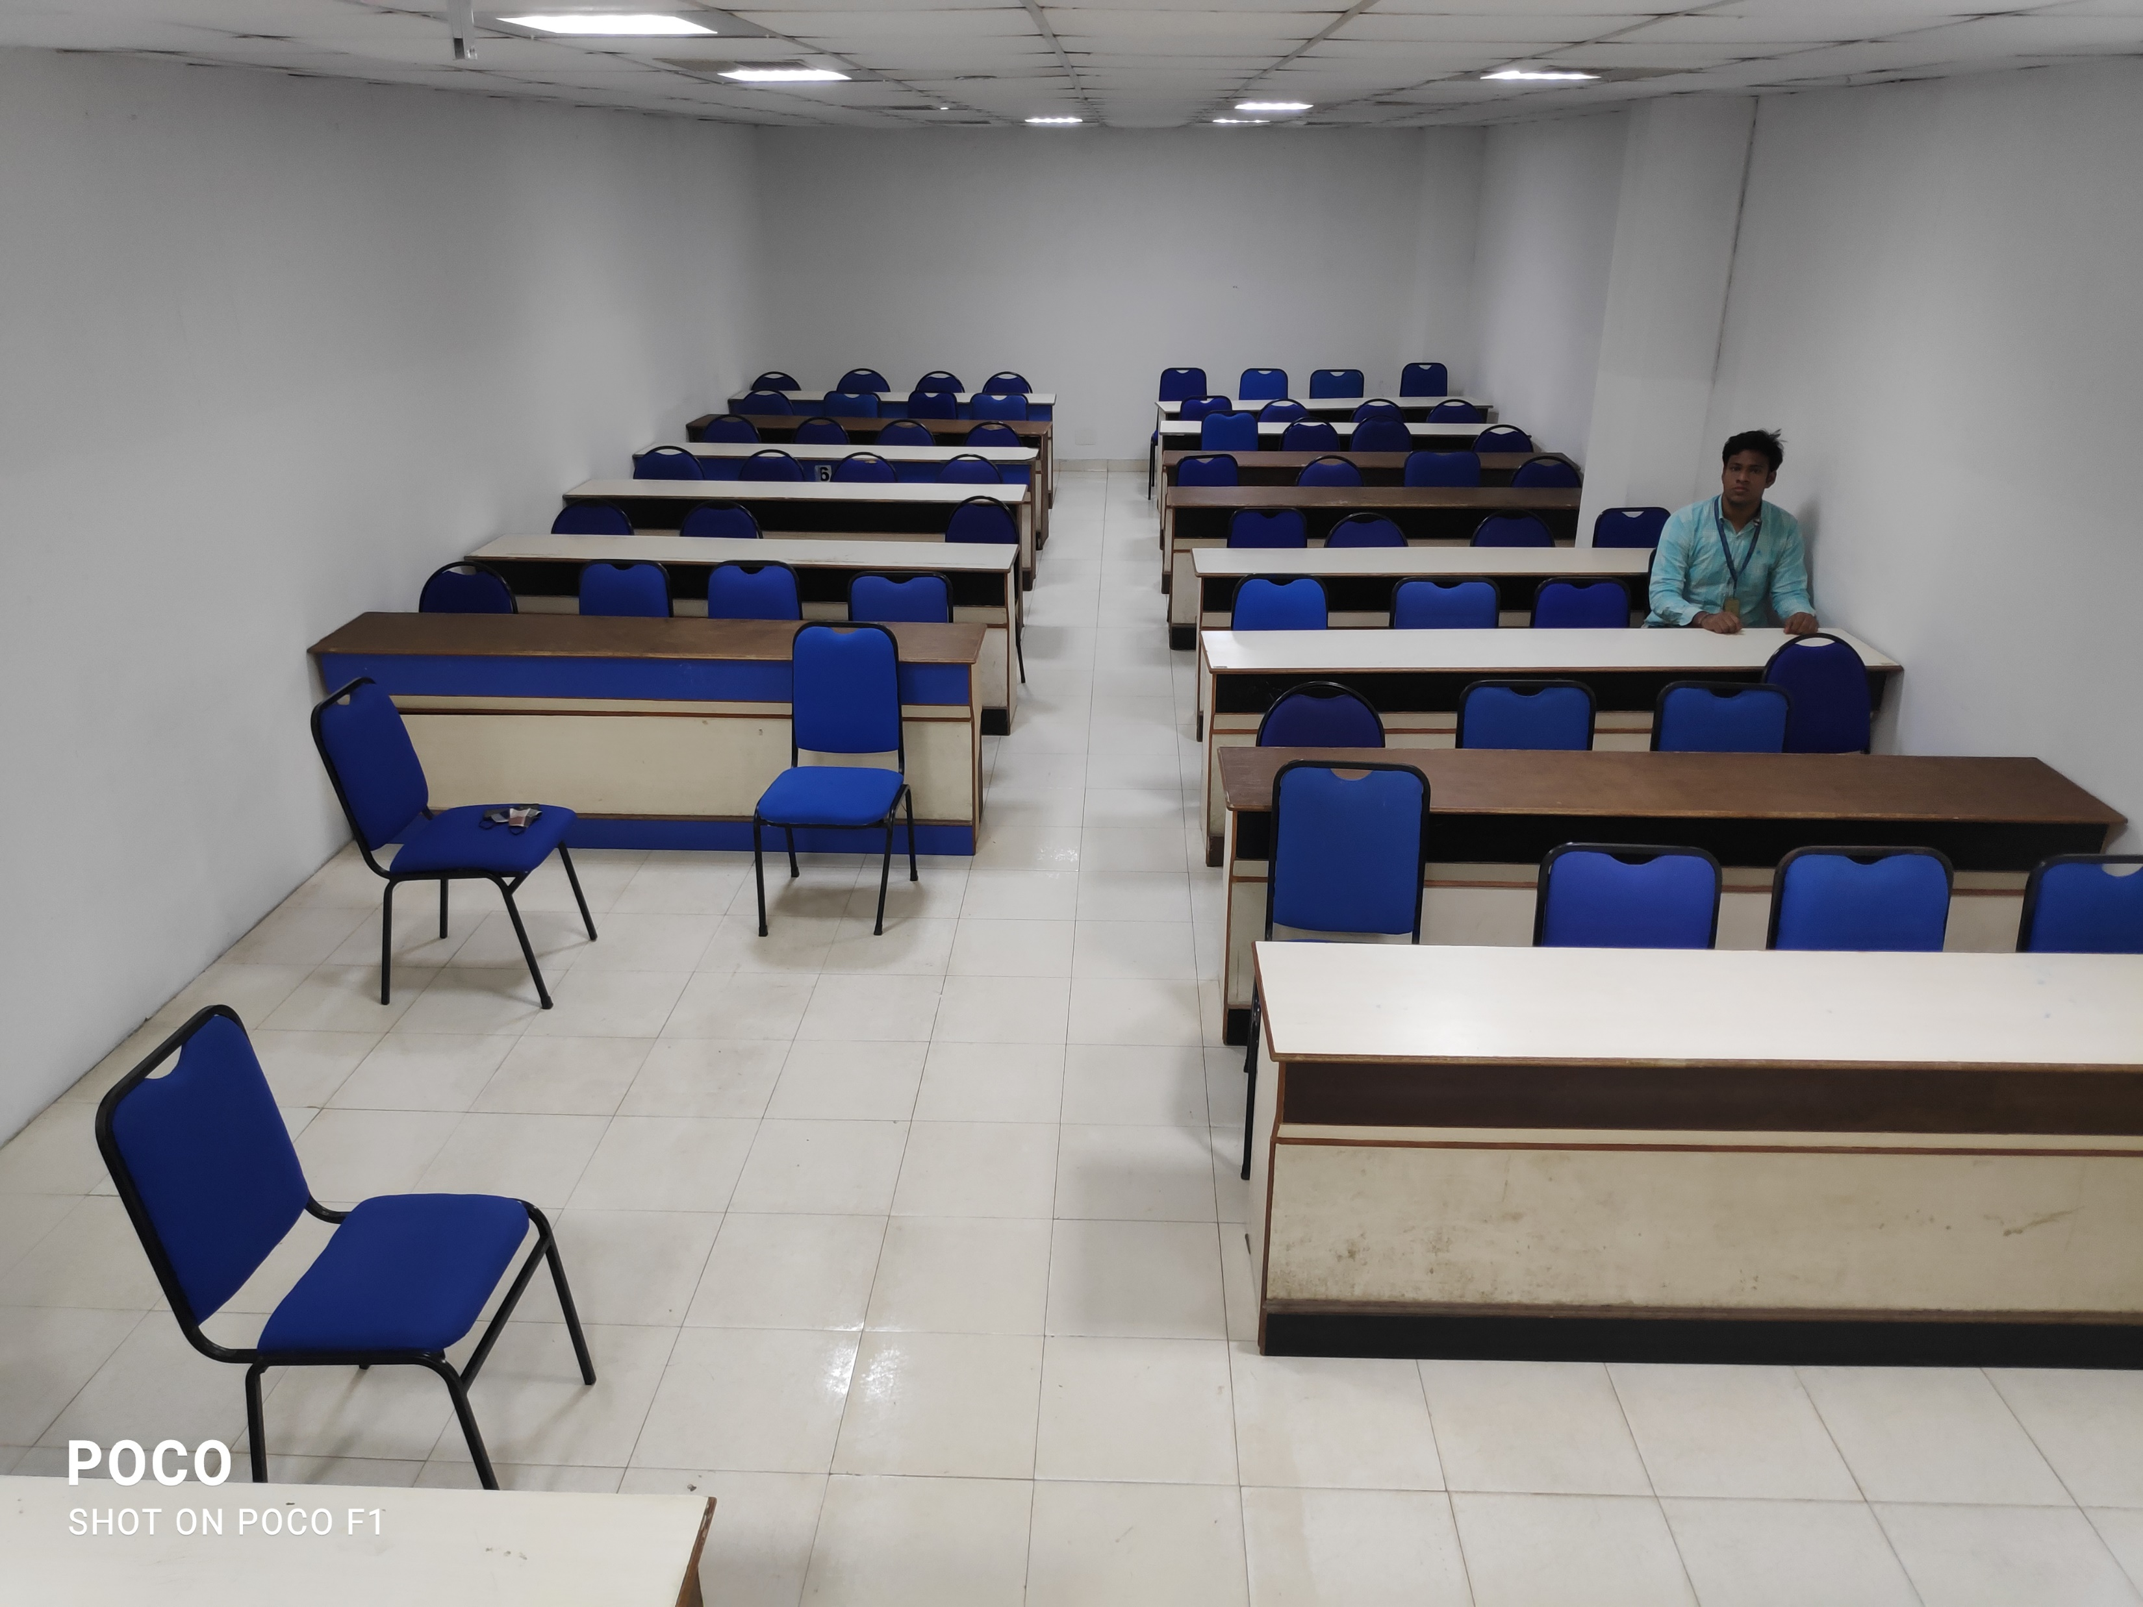
Cls3 and Cls4

Slide 11
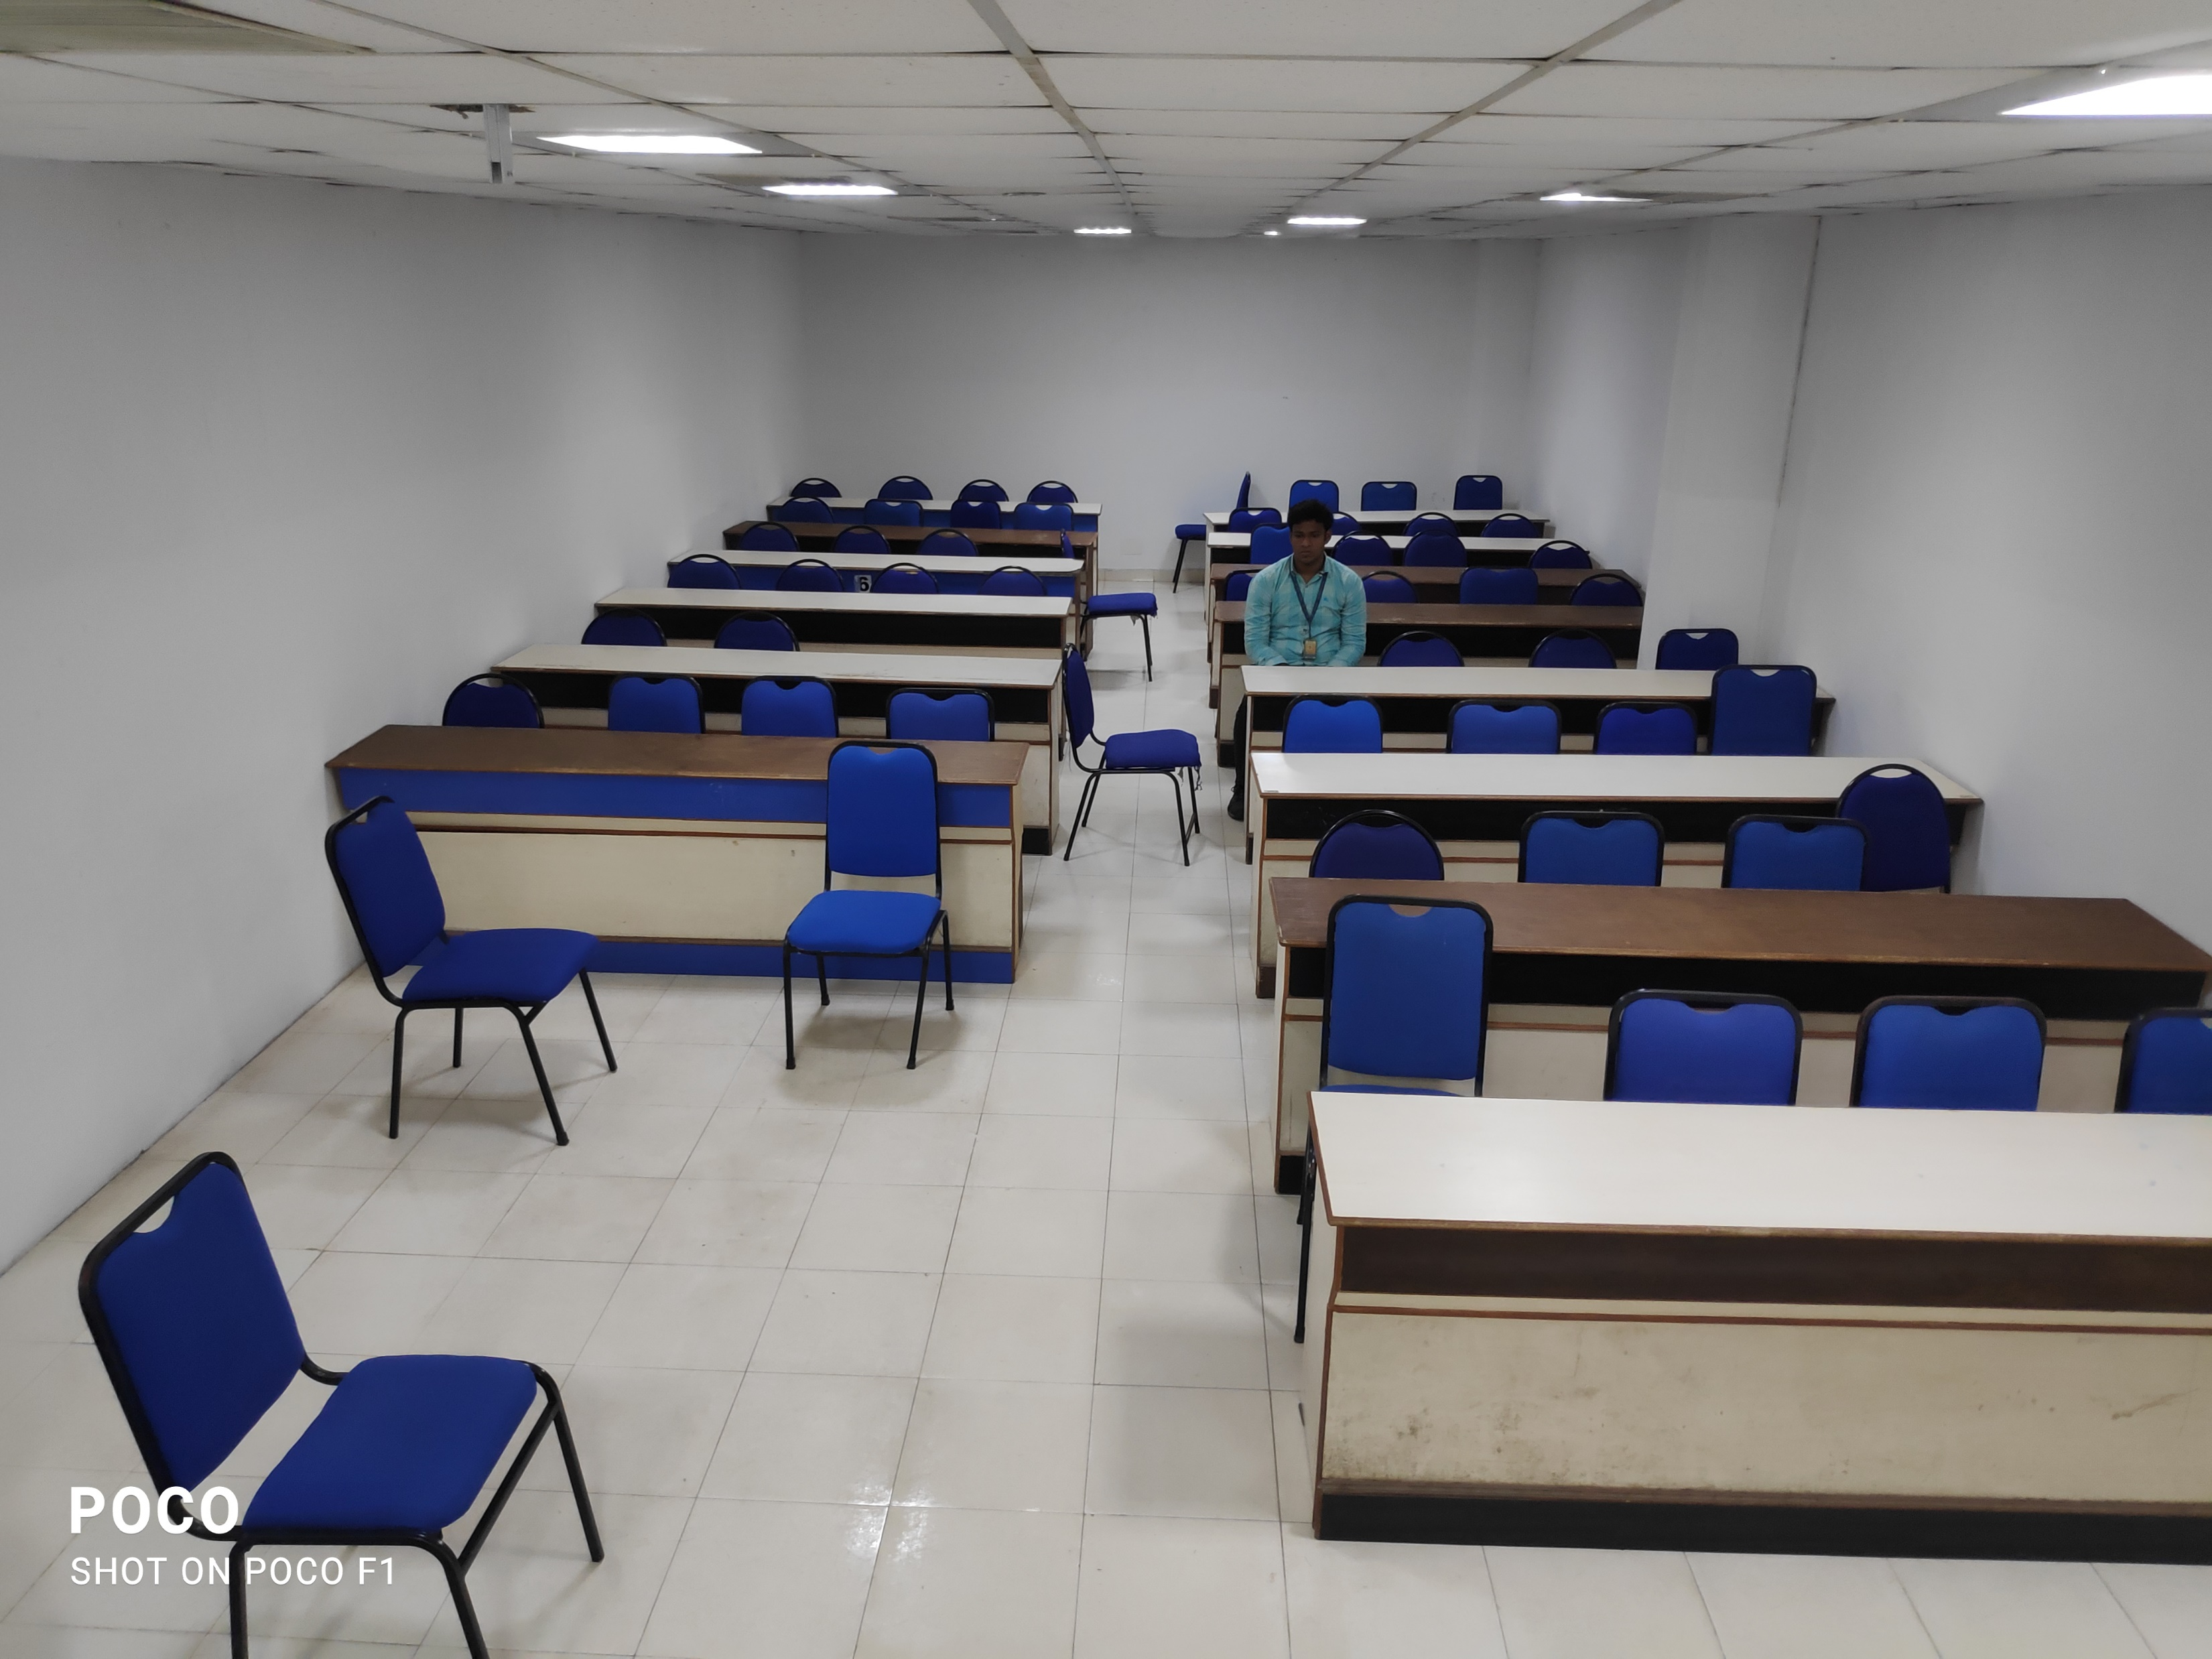
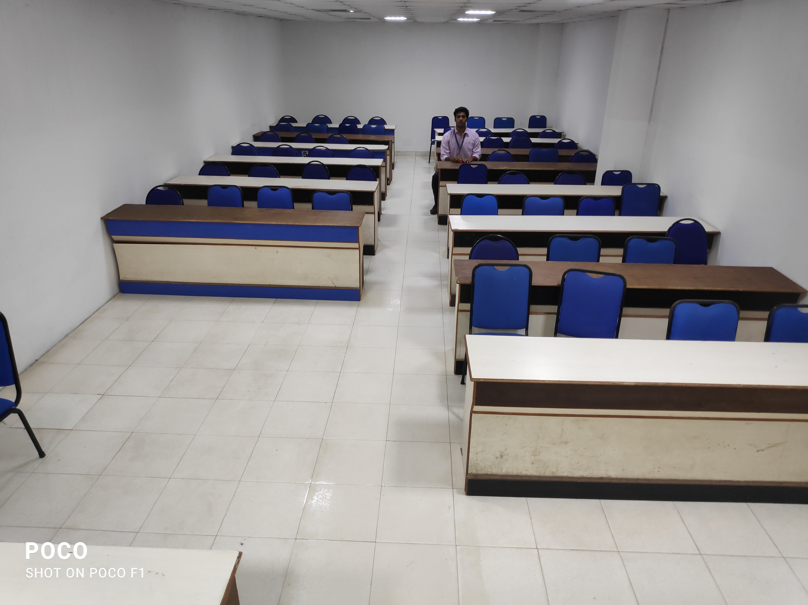
Cls5 and Cls6_1

Slide 12
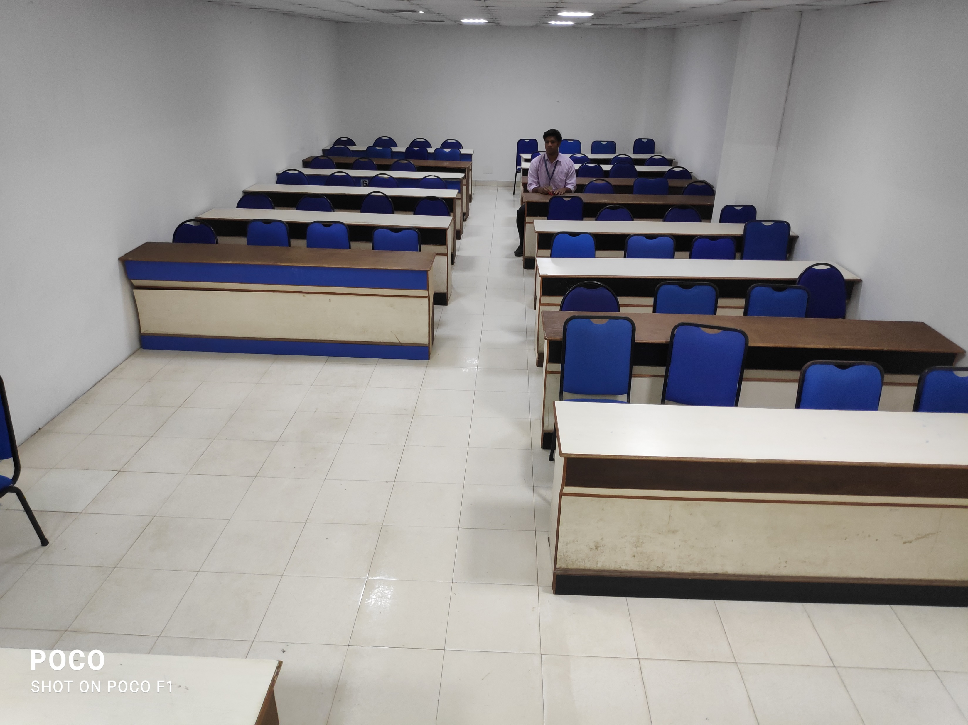
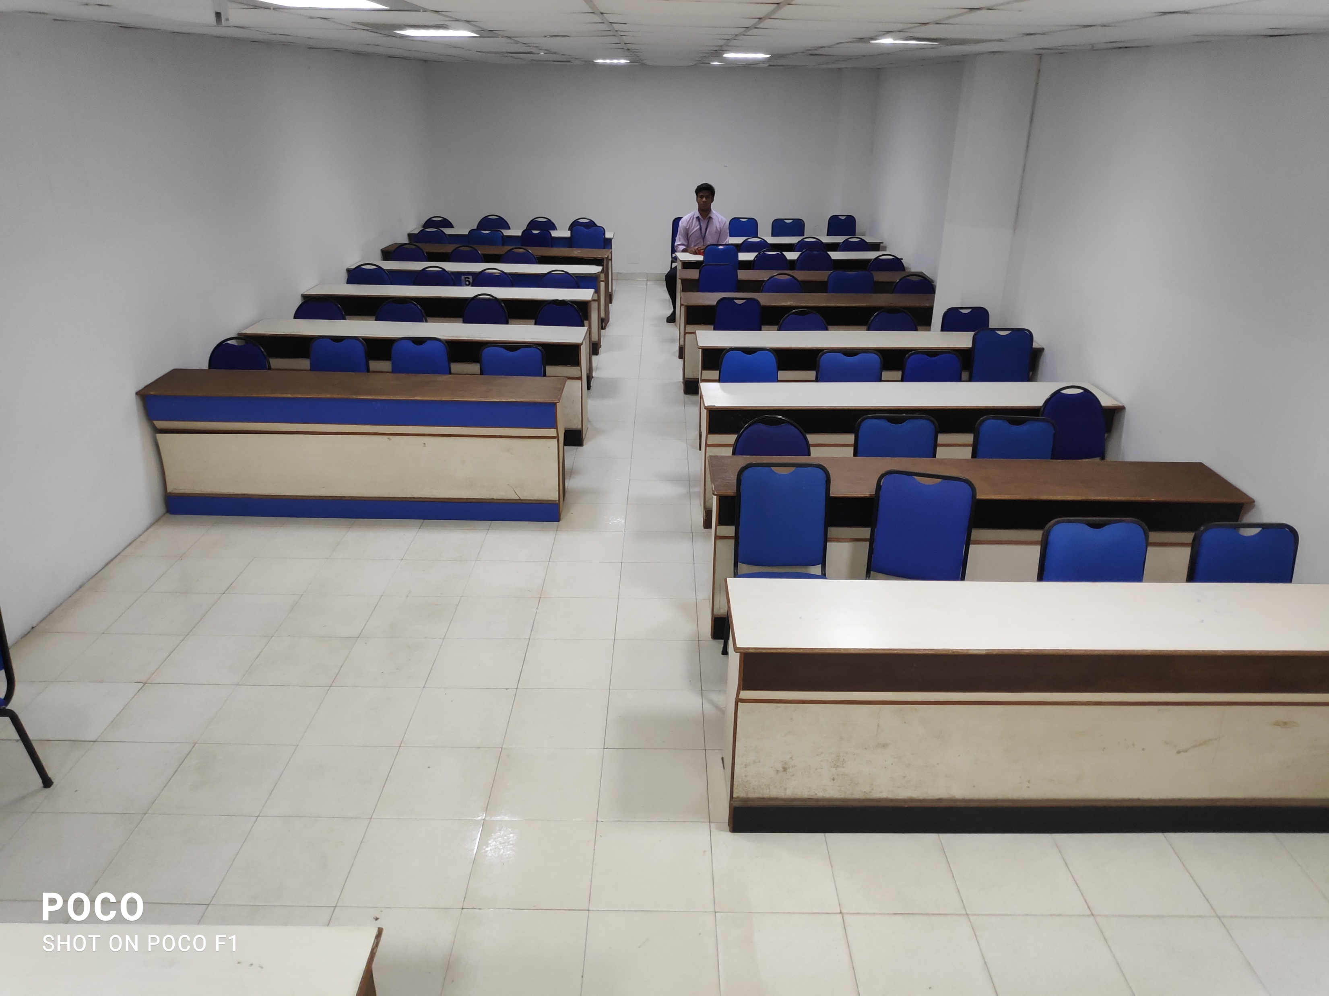
Cls6_2 and Cls7

Slide 13
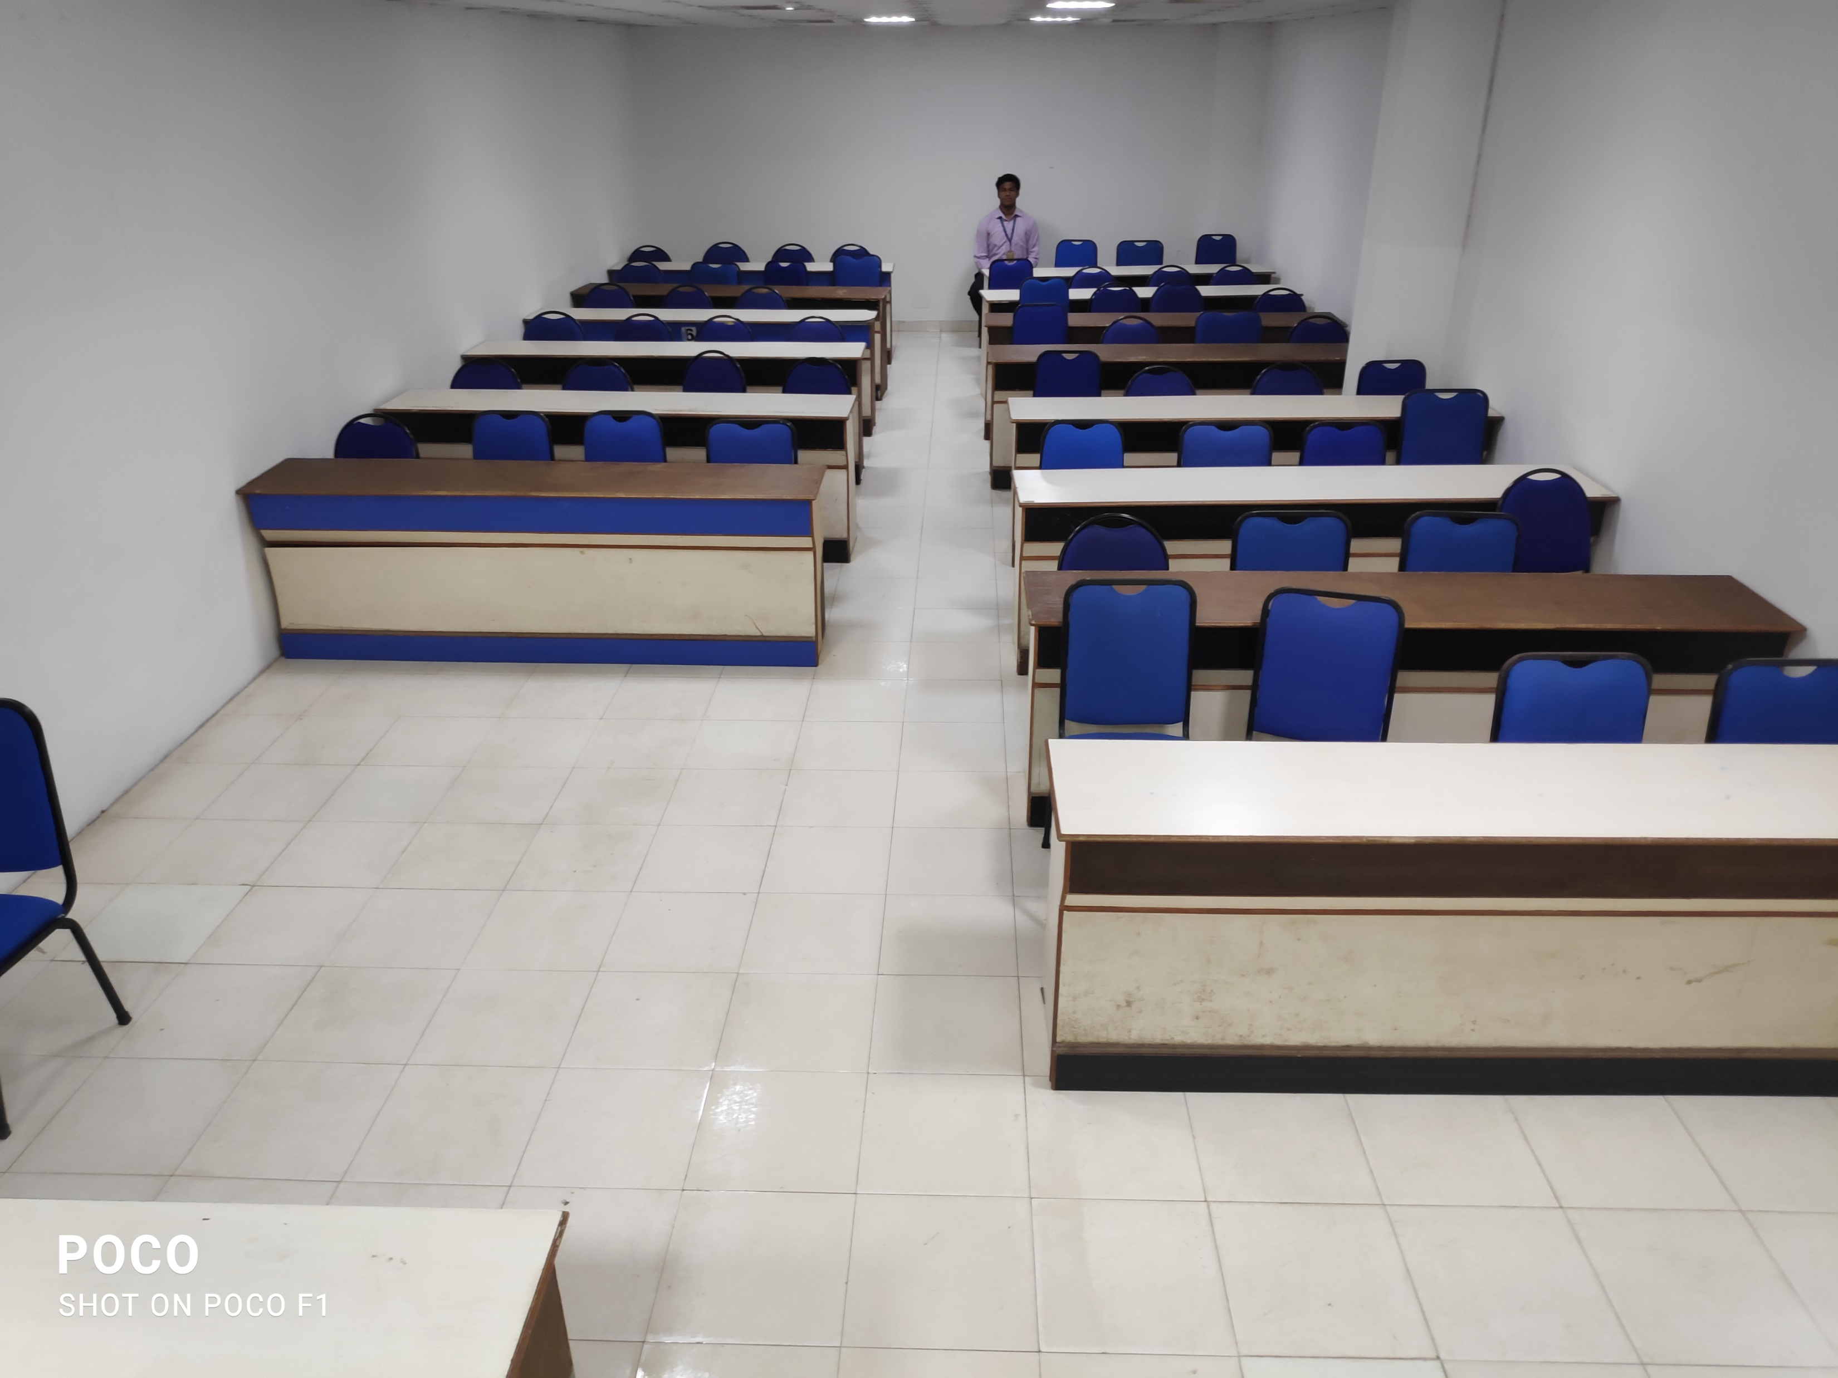
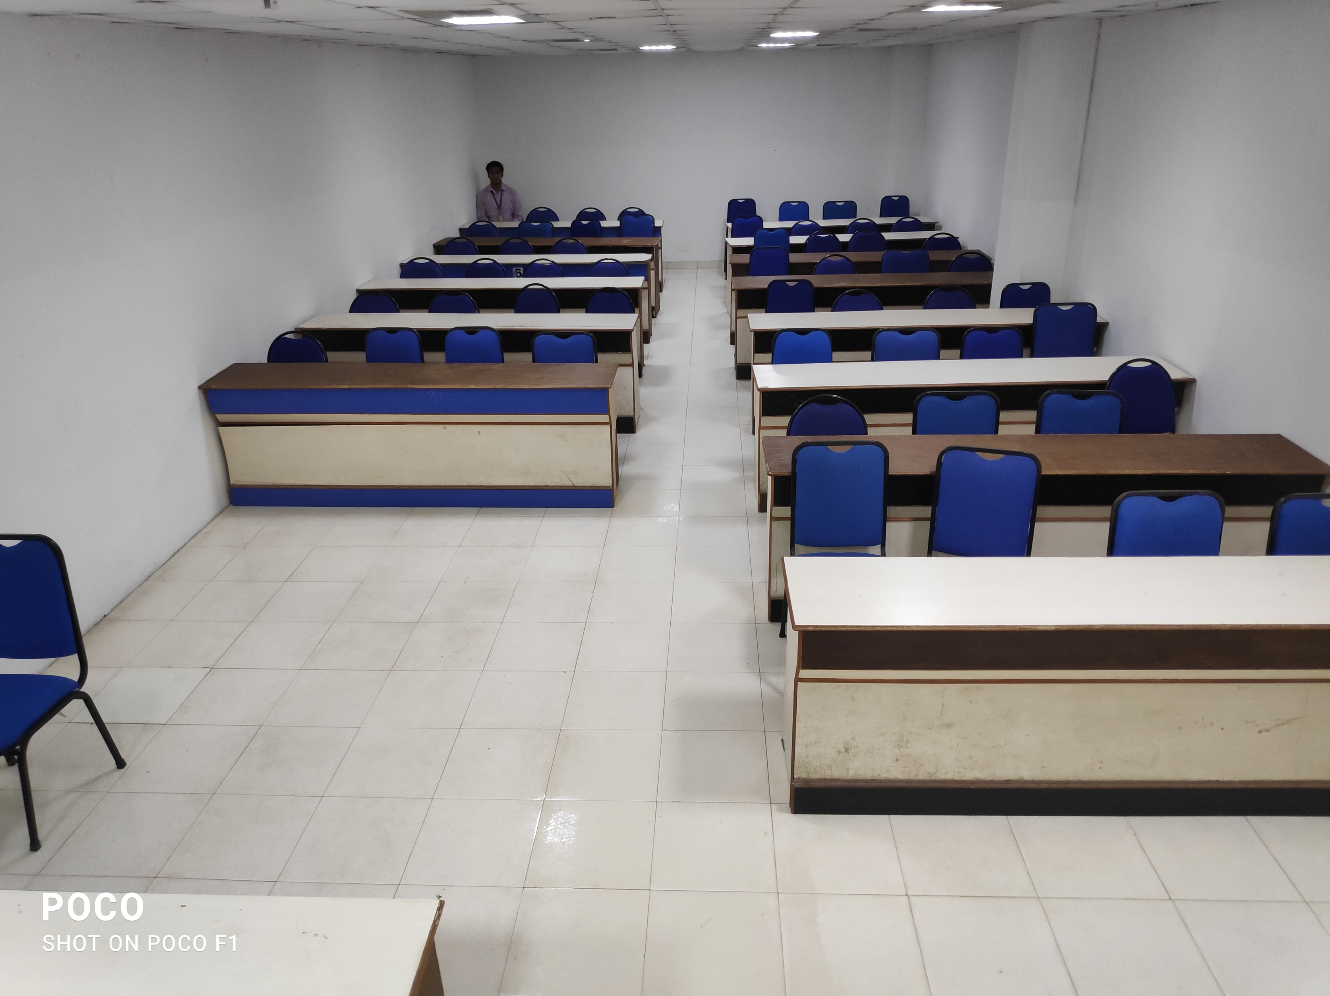
Cls8 and Cls9

Slide 14


After taking photos, we applied HOG face detection
Notes:
Cls1 through Cls6_1 is detected from HOG face detection.

Slide 15




After face detection and face recognition
Cls1
Cls2
Cls5
Cls6_1

Slide 16
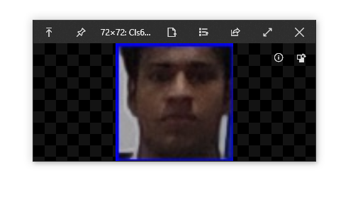
After this size the face detection does not detect face
Notes:
The 72X72 comes at the 10m or above mark of the classroom

Slide 17
Progress
Used mobile camera of 13MP and took these above mentioned pictures and tested with the algorithms.
Thus we are able to see that we cannot detect more than 10m away faces using the 13MP camera sensor
As there is no standard or uniform classroom size , we can observe many classrooms as long (15 x 5) and as wide as (8 x 20) (in meters) .
So we should use higher MP or use extra cameras for the covering the extra length.

Slide 18
Expected Outcome
As of date, we were able to detect and recognize through the algorithms mentioned.

Slide 19
References Papers
Y. Su, X. Cui, Q. Xi, R. Zhang and J. Shen, "An Industry-Ready Single PTZ-Camera Based Attendance Management System," 2020 IEEE International Conference on Multimedia & Expo Workshops (ICMEW), London, UK, 2020, pp. 1-4, doi: 10.1109/ICMEW46912.2020.9105968.
https://www.learnopencv.com/face-detection-opencv-dlib-and-deep-learning-c-python/
https://www.electronicscomp.com/raspberry-pi-8mp-noir-camera-module-v2-india?gclid=CjwKCAiA2O39BRBjEiwApB2Ikjhc_K3Lxq-xtrgZNZA4mhJy12pRJj8mdGWV0sX2t-iGZRdeBfWyRBoCfuAQAvD_BwE

Slide 20

Thank You

